Slide 1
Week 2: Chapters 3 & 4
Conflict Management (BUS-8419)

Slide 2


Chapter 3: Causes and the Source of Dysfunctional Conflict
In this Discussion:
Top 10 causes of dysfunctional conflict
Outcomes of conflict
Aspects of management and leadership

Slide 3
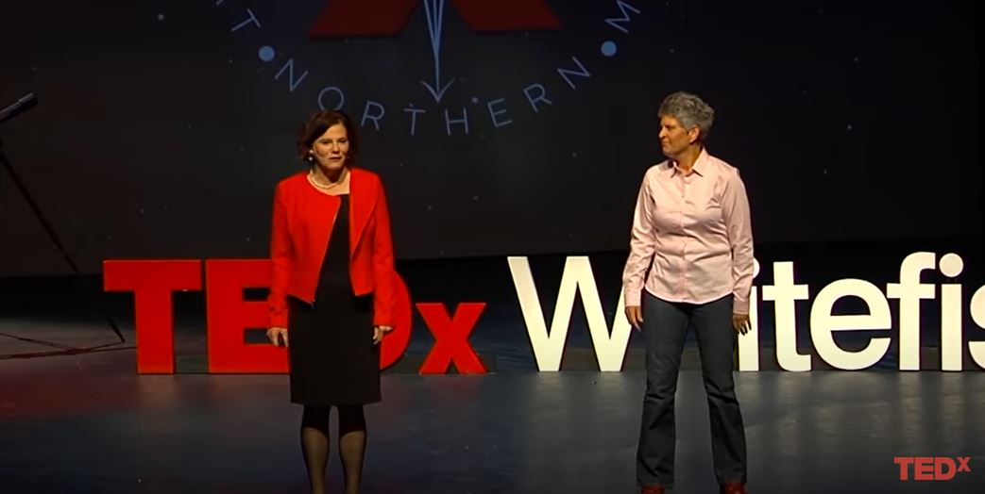
Featured Video:
Conflict – Use It, Don’t Defuse It
https://www.youtube.com/watch?v=o97fVGTjE4w

Slide 4
Chapter 1: What’s wrong with contemporary conflict management and what organizations do about it?
Let’s Talk about the Video
Justify why we need to ‘use conflict’ rather than ‘diffusing’ it.
How can this video help you as a professional and as a graduate student?
https://www.youtube.com/watch?v=o97fVGTjE4w

Slide 5

Top 10 Causes of Dysfunctional Conflict
A lack of a coherent conflict management strategy
The modern triumvirate (HR, unions and managers) pulling in different directions
A rights-based and risk-averse policy framework that institutionalizes division, dysfunction and discord

Slide 6
Top 10 Causes of Dysfunctional Conflict
4. The application of the Ulrich model of HR
5. Managers who lack the courage, the confidence or the competence to manage conflict
6. Poorly defined job roles and unclear objectives

Slide 7
Top 10 Causes of Dysfunctional Conflict
7. Organizational integrity and the perception of employees
A breakdown in communication
Uneven or unfair allocation of resources
Organizational structures and culture

Slide 8

Discussion of Selected Reading 3
Critically discuss the salient features of the reading. How does it contribute to your day to day interaction at work?

Slide 9

Three Aspects of Management and Leadership that are Central Causes of Functional Conflict
A lack of courage to deal with conflicts and relationship issues due to fear that the situation could escalate
A lack of confidence arising from poor management recruitment processes, a confusing HR policy framework, lack of clear management job design
A lack of competence arising from a lack of appropriate training and support

Slide 10


Chapter 1: What’s wrong with contemporary conflict management and what organizations do about it?
Resolution Reflection Questions
What are the main causes of conflict in your workplace?
What tools do you use to evaluate the causes of conflict?
Do you learn from previous conflicts to prevent them occurring again?

Slide 11

Defining your Expectations
of Leadership Behavior
Organizations have a set of clear values that are either written or assumed
Increasing numbers of organizations are developing a suite of leadership behaviors that are aligned to the values of the organization

Slide 12

Defining your Expectations
of Leadership Behavior
The management functions the ‘walks the talk’ approach and is well equipped to handle the complexity of managing a diverse workforce during these volatile, uncertain, complex and ambiguous (VUCA) times.

Slide 13
Resolution Reflection Questions
How do your HR, union and management colleagues work collaboratively to solve workplace problems?
How could your HR and management colleagues improve the ways in which they collaborate?
Do you have a written collaboration framework or is it assumed? If you have, what are the benefits of developing a written framework for promoting collaboration among the modern triumvirate?

Slide 14

Effective communication
comprises a series of stages
The sender decides to send a message to a receiver.
The sender chooses a means by which to encode the message – talking, a memo, an e-mail, etc.

Slide 15

Effective communication
comprises a series of stages
He or she delivers the message through the appropriate medium – speech, writing and delivering a memo or sending the e-mail, etc.
The receiver receives the message and decodes it – reading, listening, etc.

Slide 16

Effective communication
comprises a series of stages
5. The receiver sends a message back to the sender to confirm that the message has been received and understood – he or she gives feedback or asks questions to elicit more information.

Slide 17
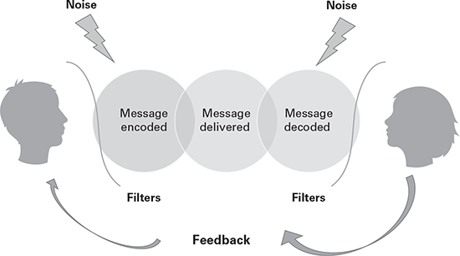
The communication process

Slide 18

Outcomes of Conflict
Different positions or outcomes of conflict:
Win-lose outcome: Occurs when one person obtains his or her desired ends in the situation and the other individual fails to obtain what is desired.
Lose-lose outcome: In this situation, there is no winner.
Win- win outcome: This is the most desirable as both parties win.

Slide 19

Chapter 3 Key Learning Points
There are complex and varied causes of conflict, many of which are routinely ignored or misunderstood.
The causes of conflict can be categorized into two broad areas: human and organizational.

Slide 20
Chapter 3 Key Learning Points
Risk-averse, confrontational and adversarial organizational rules and procedures are the most significant causes and perpetuators of dysfunctional conflict.
Organizations can create rules, policies, systems and structures that reduce the potential for dysfunctional conflict and encourage transformational conflict.

Slide 21

Conclusion
To resolve conflict we must first understand its root cause.
Conflict arises from unmet needs, which creates powerful emotions, perceptions and reactions.

Slide 22
References
Adams, L (2016) HR Disrupted – It’s time for something different, Practical Inspiration Publishing, London
CIPD (2015) Getting under the Skin of Workplace Conflict: Tracing the experiences of employees, https://www.cipd.co.uk/Images/getting-under-skin-workplace-conflict_2015-tracing-experiences-employees_tcm18-10800.pdf)
Covey, S R (2012) The 7 Habits of Highly Effective People, Simon & Schuster, New York
Great Place to Work Institute (2014) Organizational Values: Are they worth the bother? How values can transform your business from good to great, Great Place to Work Institute, London
ILM and QA (2014) 2020 Vision: Future trends in leadership and management; see https://www.i-l-m.com/~/media/ILM%20Website/Documents/research-reports/future-trends/ilm-research-reports-future-trends%20pdf.ashx
Ulrich, D (1997) Human Resource Champions: The next agenda for adding value and delivering results, Harvard Business Press, Boston, MA

Slide 23
Chapter 4: Managing Conflict as an Entrepreneur (Special Topic)
In this Discussion:
Culture, conflict and team management in I4H
Compromise or else: Managing conflicts in the negotiation process

Slide 24
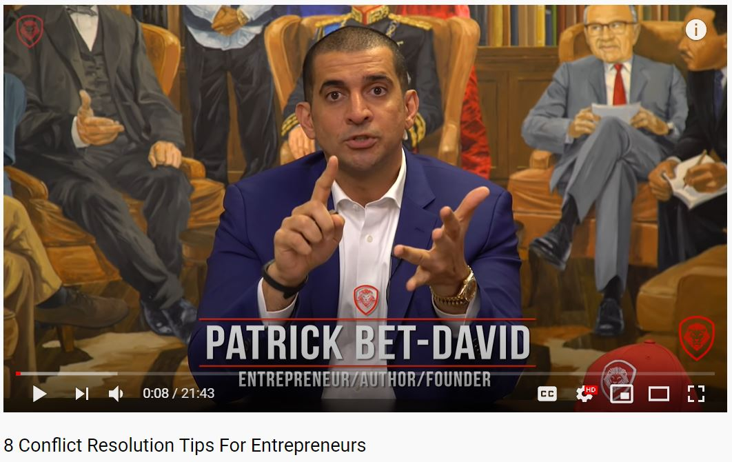
Featured Video:
8 Conflict Resolution Tips for Entrepreneurs
https://www.youtube.com/watch?v=fYgv039X_FU

Slide 25
Chapter 1: What’s wrong with contemporary conflict management and what organizations do about it?
Let’s Talk about the Video
Identify the five levels of dealing with conflict . What do you think are the skills that are essential for entrepreneurs in the 21st century?
How can those skills be applied in business? Explain.
https://www.youtube.com/watch?v=fYgv039X_FU

Slide 26

First Featured Reading
Culture, Conflict and Team management in I4H: Experiential learning in business practice to support community development entrepreneurship
By Calvin, J. R., & Igu, J. (2019)
Journal of Organizational Culture, Communications and Conflict

Slide 27
Introduction
The Carey Business School’s Innovation for Humanity (I4H) project leverages experiential learning in its collaboration with international partners that work towards achieving the United Nation’s 17 Sustainable Development Goals (SDGs).
The theory behind the development and evolution of I4H is rooted in literature that describes culture, experiential learning and the business of social impact the I4H project equips teams with cultural and conflict management training, among others.

Slide 28

Aims of the Paper
To describe I4H, a Business School experiential learning program, exploring the model that I4H uses to address culture and conflict in teaming in its international projects.
To identify student challenges and solutions to problem solving in the context of culture, conflict and teaming in I4H and proposes that these lessons learned are transferable in the context of similar experiential learning projects.

Slide 29
Experiential Learning Theoretical Frameworks Guiding I4H Design in Culture, Conflict and Team Management
Experiential learning is an effective way to expose teams to cultural learning in organizational settings.
Schein (1990) answers the question; “What is culture?” by employing a multi-approach paradigm. He states, “culture, like role, lies at the intersection of several social sciences and reflects some of the biases of each-specifically, those of anthropology, sociology, social psychology, and organizational behavior”.

Slide 30

Experiential Learning Theoretical Frameworks Guiding I4H Design in Culture, Conflict and Team Management
In the context of I4H, lessons are learned in the safety of an academic environment with students guided by faculty and their collaborating sponsors.
Professionals are able to develop new skills and perspectives, learn new teaming strategies and encounter new cultures for the first time.
The challenges are overcome through modules deliberately designed for these eventualities.

Slide 31
Research Findings
In the last two years, I4H has worked with 32 sponsors from five countries. Students reported five groups of challenges:
  Cultural challenges, communication-based challenges, conflict based challenges, team related challenges, and unforeseeable challenges.
  These challenges were mitigated using concepts from I4H and its supporting course, solving organizational problems.

Slide 32

Conclusion
Carey Business School’s I4H experiential learning model is transferrable and creates value through skill transfer, social impact and reciprocal community development.
The I4H program successfully deals with multicultural issues in international collaboration, conflict resolution and teaming.
It has direct impact through bilateral knowledge and skill transfer, and indirect impact through initiatives that it inspires, and fosters.

Slide 33

Second Featured Reading
Compromise or else: Managing conflicts in the negotiation process.
Vojvodic, K., Martinovic, M., & Pusic, A. (2019)
Varazdin Development and Entrepreneurship Agency

Slide 34

Introduction
Raines (2013): To be human is to experience conflict within ourselves, between individuals, and among groups.
Gamble and Gamble (2013): Conflicts may arise from perceived individual differences, scarcity of resources, rivalries, relationship disagreements, and misinterpretations.
Axelrod and Johnson (2005): Conflict is consisting of contradiction of interests, perception of threat or loss, mutuality, and interdependency.

Slide 35

Introduction
Doherty and Guyler (2008): Conflict is ultimately about a drive for some kind of change in the status quo.
Rahim (2011): Conflict is an important social concept and one of the major organisational phenomena.
Lang (2009): Conflict management is an unavoidable part of a manager’s role in organization.

Slide 36

Aims of the Paper
To identify the ways managers solve the conflicts that emerge during the negotiating process.
An additional aim of the paper is to identify the factors that influence the choice of conflict management strategy. For that purpose, the survey has been conducted among 256 Croatian managers.

Slide 37
Insights into Conflict Resolution Styles
Conflict style refers to one’s preferred response to conflict. However, different conflict styles are useful for different purposes (Barsky, 2014).
The impact of communication as a conflict resolution mechanism should be emphasized. In such context, Eisenkoph (2018) asserts that conflict resolution is less successful even in the long term if initial conflict intensity is rather high.
Pazos (2012) outlines that commitment to team goals is a significant predictor of successful conflict management.

Slide 38
Insights into Conflict Resolution Styles
Nesterkin and Porterfield (2016) posited that team support plays an important role in protecting the team from the negative effects of conflict and contributes to the development of team cohesion.
Chung-Yan and Moeller (2010) stress that focus should not be only on managing the conflict, but also on the psychosocial costs when adopting particular conflict styles. In the literature, there are many classifications of different styles of handling conflicts.

Slide 39

Insights into Conflict Resolution Styles
McCollum (2009) divides conflict management styles into five groups: submissive, evasive, collaborative, competitive and cooperative
Lambert and Myers (1999) identify four conflict-resolution styles, i.e., avoidance, competition, adaptation and cooperation.

Slide 40

Research Findings
The results of the study reveal five factors that affect the manner in which conflicts are resolved. Those factors consist of company size, hierarchical level of the manager, aims of the negotiating process, negotiator’s autonomy and the importance of teamwork.

Slide 41

Research Findings
It is important for managers to better understand their own conflict management style in order to improve responses to conflict, to increase the objective outcomes of negotiations and to prevent the conflict from happening.

Slide 42
Conclusion
Business negotiations form an integral part of daily business operations for managers at all hierarchical levels.
Negotiators are often faced with dealing with different types of conflicts with the opposite party.

Slide 43
Chapter 4 Key Learning Points
In the first journal article, it was known that in I4H, a Business School experiential learning program, a model has been explored to address culture and conflict in teaming in its international projects.

Slide 44
Chapter 4 Key Learning Points
In the second journal article reading, business negotiations form an integral part of daily business operations for managers at all hierarchical levels. In this context, negotiators are often faced with dealing with different types of conflicts with the opposite party.

Slide 45
References
Calvin, J. R., & Igu, J. (2019). Culture, conflict and team management in I4H: Experiential learning in business practice to support community development entrepreneurship. Journal of Organizational Culture, Communications and Conflict, 23(1), 1-14.
Vojvodic, K., Martinovic, M., & Pusic, A. (2019). Compromise or else: Managing conflicts in the negotiation process. Varazdin: Varazdin Development and Entrepreneurship Agency (VADEA).

Slide 46
Readings for Next Class
Measuring the costs of conflict
The Psychology of conflict and conflict management
Selected Journal Readings

Slide 47
That’s it. Enjoy reading and participate more.
Thank you!

